Slide 1


Francisco Lodi B.
April 10, 2023

Slide 2

Outline
Executive Summary
Introduction
Methodology
Results
Conclusion
Appendix

Slide 3
Executive Summary
Summary of methodologies and results
The methodologies used mainly are web scraping with API, JSON, Request and BeautifulSoup, then the treatment and cleaning of data in Pandas and basic Exploratory Analysis with MySql and scatter graphs with Pandas. The visualization of the main indicators was carried out with Plotly Dash and the mapping with Folium. Finally, a predictive analysis was made using the Sklearn library, addressing SVM models, classification trees and logistic regression, dividing the data into training and test.
All the machine learning models had good results over 80% accuracy, the logistic regression model stands out slightly more with 84% accuracy.
Launch sites have different success rates. CCAFS LC-40 has a 60% success rate, while KSC LC-39A and VAFB SLC 4E have a 77% success rate.
With heavy payloads the successful landing or positive landing rate are more for Polar,LEO and ISS.

Slide 4
Introduction
SpaceX company focused on rocket launches, only Falcon 9 has a cost of 62 million dollars; other vendors cost more than $165 million each, much of the savings due to SpaceX being able to reuse the first stage. If it is possible to determine whether the first stage will land, the cost of one launch can be determined. This information can be used if an alternative company wants to bid against SpaceX for a rocket launch.
This presentation summarizes the main results of the exploratory analysis of SpaceX's Falcon 9 rocket launches, seeking to predict which are the conditions that allow the greatest number of successful launches to be generated.
What is the causality of each of the characteristics, being able to determine the significance of the launch site, weight of the load and engineering characteristics.

Slide 5

Section 1

Slide 6
Methodology
Executive Summary
Data collection methodology:
Rest API
Web Scrapping from Wikipedia
Perform data wrangling
Data cleaning of null values.
Perform exploratory data analysis (EDA) using visualization and SQL
Perform interactive visual analytics using Folium and Plotly Dash
Perform predictive analysis using classification models
Regression Logistic, SMV, KNN and Decision Tree

Slide 7
Data Collection
SpaceX launch data that is collected from the SpaceX Rest API.
This API provides data about launches, including information about the rocket used, the payload delivered, the launch specifications, the landing specifications, and the landing outcome.
The API starts with api.spacexdata.com/v4/.
Another source of data for getting Falcon 9 is a web scaraping via BeautifulSoup.
SpaceX
REST API
Return Data
In JSON
Normalize data
CSV file
Consolidated table from different sources
Ready data
Get HTML Response
Extrat data using BeautifulSoup
Normalize data
CSV file

Slide 8
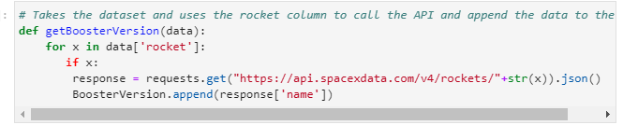
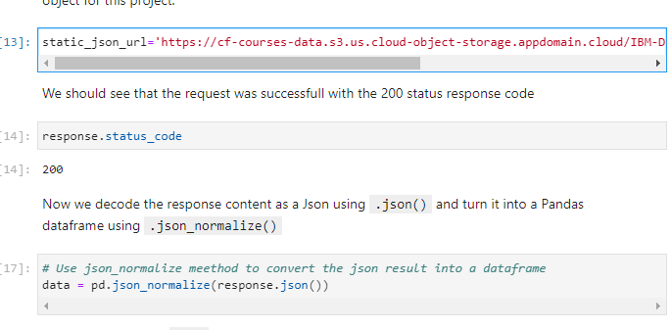
Data Collection – SpaceX API
GitHub URL: https://github.com/franciscolodi/testrepo/blob/67c1a15d453a5861965458d464084ebbae4a1401/jupyter-labs-spacex-data-collection-api.ipynb
Place your flowchart of SpaceX API calls here

Slide 9
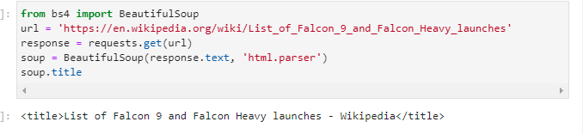
Data Collection - Scraping
GitHub URL: https://github.com/franciscolodi/testrepo/blob/67c1a15d453a5861965458d464084ebbae4a1401/jupyter-labs-spacex-data-collection-api.ipynb
Place your flowchart of web scraping here

Slide 10
Data Wrangling
Check null values
Calculate missing values
Calculate the mean
Replace missing value with the mean
GitHub URL:
https://github.com/franciscolodi/testrepo/blob/67c1a15d453a5861965458d464084ebbae4a1401/jupyter-labs-spacex-data-collection-api.ipynb

Slide 11
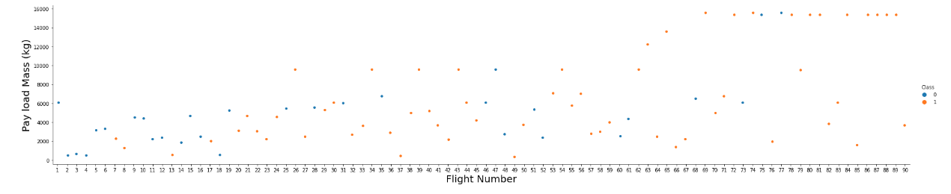
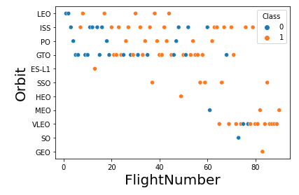
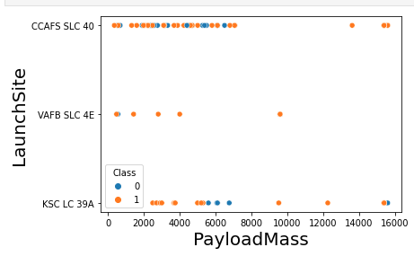
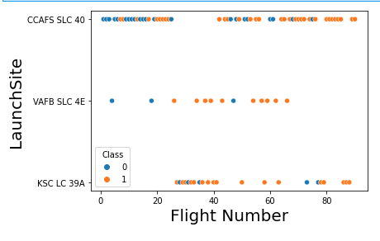
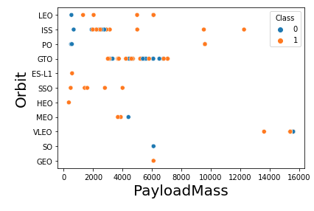
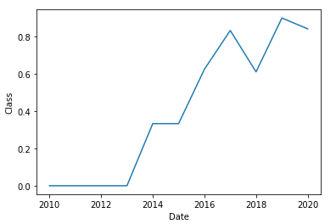
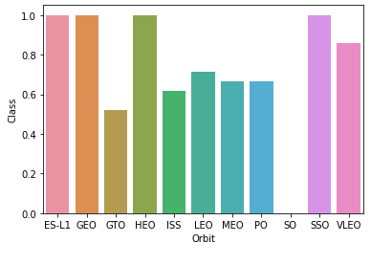
EDA with Data Visualization
GitHub URL:
https://github.com/franciscolodi/testrepo/blob/2ea7940457ec00ca67e380046d162a86add4ac5c/jupyter-labs-eda-dataviz.ipynb

Slide 12
EDA with SQL
Displaying the names of the unique launch sites in the space mission.
Displaying 5 records where launch sites begin with the string ‘KSC.
Displaying the total payload mass carried by boosters launched by NASA (CRS).
﻿﻿Displaying average payload mass carried by booster version F9 v1.1.
Listing the date where the successful landing outcome in drone ship was achieved.
Listing the names of the boosters which have success in ground pad and have payload mass greater than 4000 but less than 6000.
Listing the total number of successful and failure mission outcomes.
Listing the names of the booster_versions which have carried the maximum payload mass.
Listing the records which will display the month names, successful landing_outcomes in ground pad booster versions, launch_site for the months in year 2017.
Ranking the count of successful landing _outcomes between the date 2010 06 04 and 2017 03 20 in descendingorder.
GitHub URL: https://github.com/franciscolodi/testrepo/blob/6afc9ff3cff0fdffb0cff7f818cc6a8741ca8f9d/Copia_de_DB0201EN_PeerAssign_v5_SQLite.ipynb

Slide 13
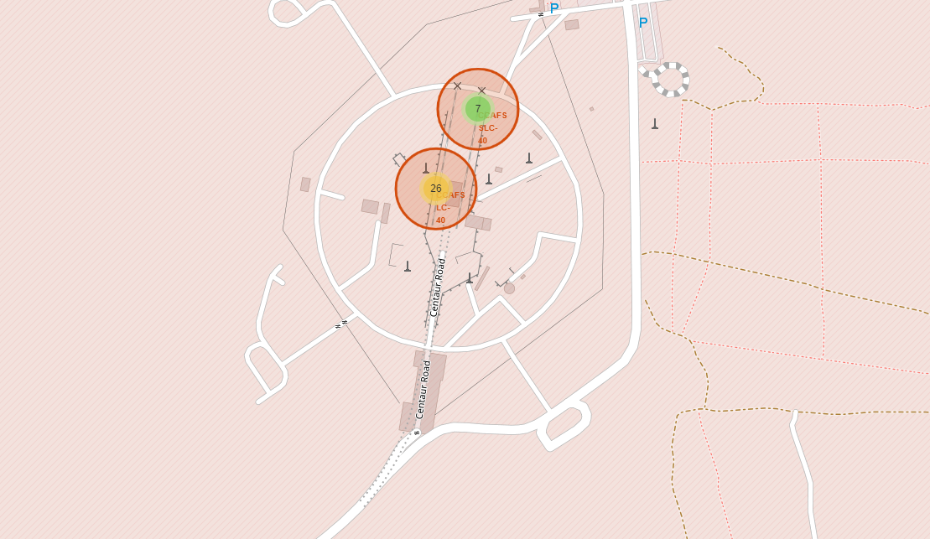
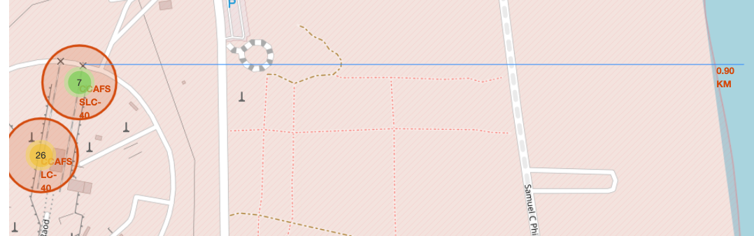
Build an Interactive Map with Folium
Map markers have been added to the map with the goal of finding an optimal location for successful launches.
GitHub URL: https://github.com/franciscolodi/testrepo/blob/dbf05425ed3eda7e38e30a2bcc7b921b1635a2c0/lab_jupyter_launch_site_location.ipynb

Slide 14
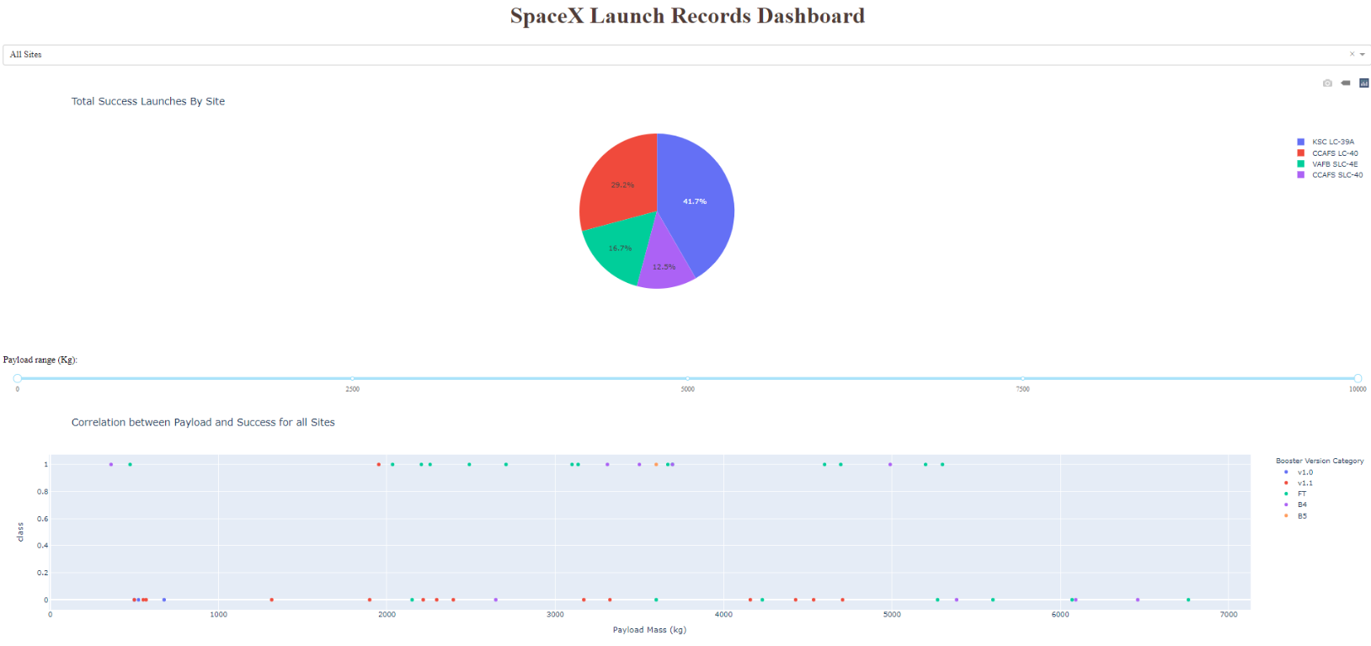
​Buscar detalles
157 / 5,000
Resultados de traducción
Traducción
A Plotly Dash app was built for users to perform interactive visual analysis on SpaceX launch data on real time
​Buscar detalles
157 / 5,000
Resultados de traducción
Traducción
A Plotly Dash app was built for users to perform interactive visual analysis on SpaceX launch data on real time
Build a Dashboard with Plotly Dash
A Plotly Dash app was built for users to perform interactive visual analysis on SpaceX launch data on real time
GitHub URL: https://github.com/franciscolodi/testrepo/blob/dbf05425ed3eda7e38e30a2bcc7b921b1635a2c0/lab_jupyter_launch_site_location.ipynb

Slide 15
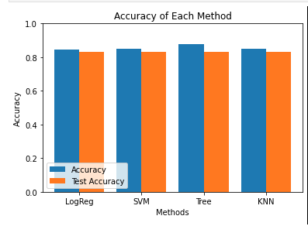
Predictive Analysis (Classification)
All the machine learning models had good results over 80% accuracy, the logistic regression model stands out slightly more with 84% accuracy.
GitHub URL:
https://github.com/franciscolodi/testrepo/blob/86ffb21084ff90f82d0be68403dec0946f9ba296/SpaceX_Machine%20Learning%20Prediction_Part_5.ipynb

Slide 16
Results
The SVM, KNN, DT and Logistic Regression models give good results in terms of prediction accuracy for this data set.
Low weight payload performs better than heavier payloads.
SpaceX lunch success rates are directly proportional to the time in years that they will eventually perfect the lunches.
KSC LC 39A had the most successful launches of all the sites.
Orbit GEO, HEO, SSO, ES L1 has the best success rate.

Slide 17

Section 2

Slide 18
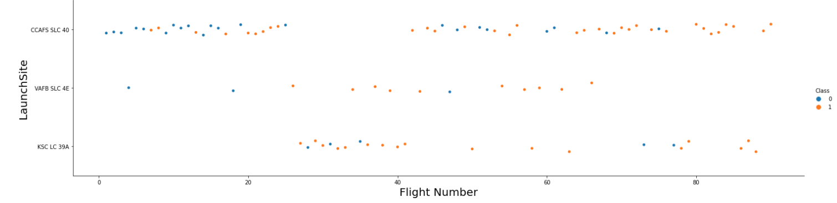
Flight Number vs. Launch Site
VAFB SLC 4E has a higher success rate
Launches from the site of CCAFS SCL 40 are significantly higher than launches form other sites.

Slide 19
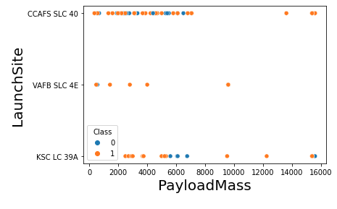
Payload vs. Launch Site
Payload vs. The launch site scatter point chart you will find for the VAFB-SLC launch site no rockets are launched for a heavy payload mass (greater than 10000).

Slide 20
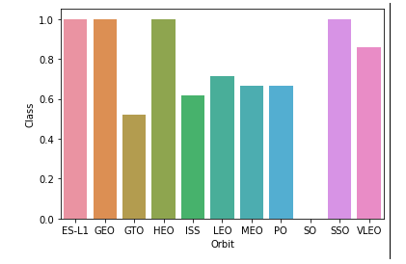
Success Rate vs. Orbit Type
ES-L1, GEO, HEO, SSO are the highest success rate.

Slide 21
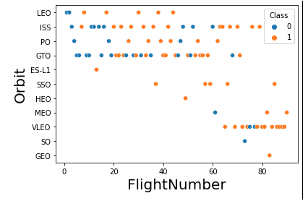
Flight Number vs. Orbit Type
LEO orbit the success appears related to the number of flights; on the other hand, there seems to be no relationship between flight number when in GTO orbit.

Slide 22
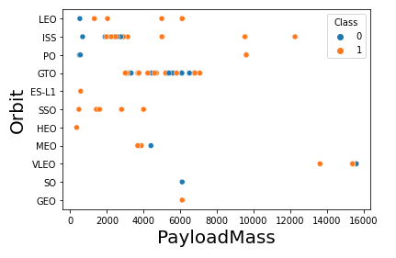
Payload vs. Orbit Type
With heavy payloads the successful landing or positive landing rate are more for Po, LEO and ISS.
However for GTO we cannot distinguish this well as both positive landing rate and negative landing(unsuccessful mission) are both there here.

Slide 23
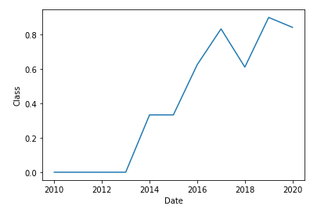
Launch Success Yearly Trend
We can observe that the sucess rate since 2013 kept increasing till 2020

Slide 24
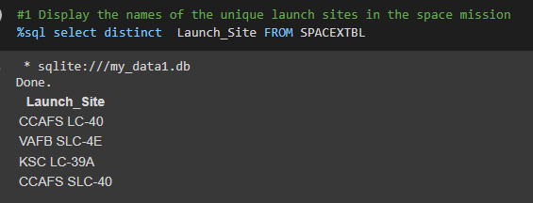
All Launch Site Names

Slide 25
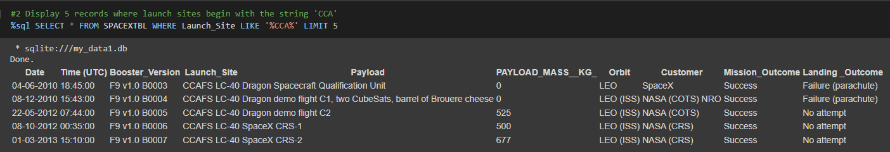
Launch Site Names Begin with 'CCA'

Slide 26
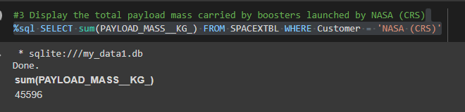
Total Payload Mass

Slide 27
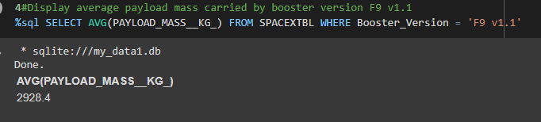
Average Payload Mass by F9 v1.1

Slide 28
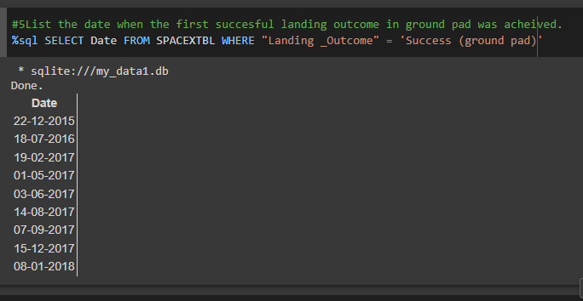
First Successful Ground Landing Date

Slide 29
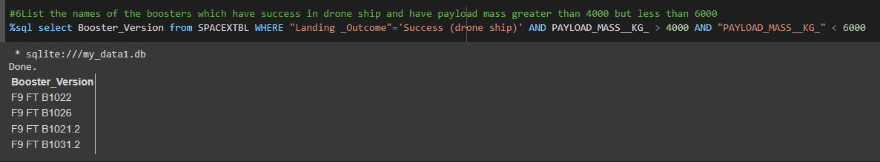
Successful Drone Ship Landing with Payload between 4000 and 6000

Slide 30
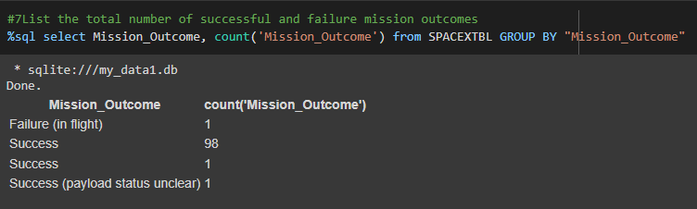
Total Number of Successful and Failure Mission Outcomes

Slide 31
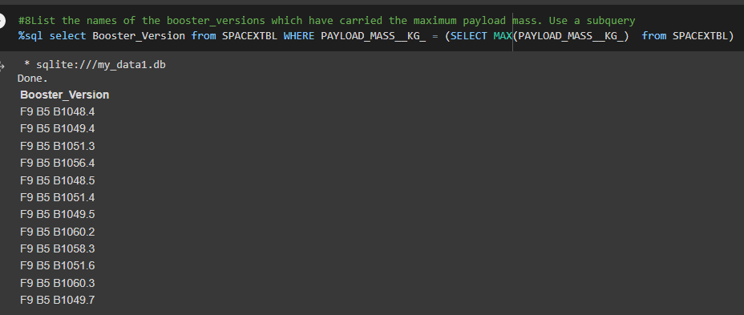
Boosters Carried Maximum Payload

Slide 32
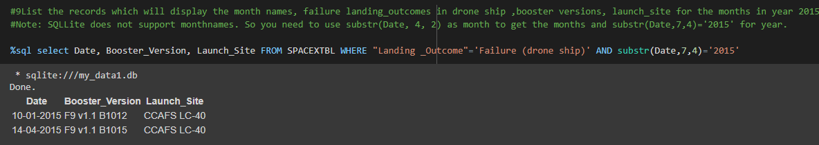
2015 Launch Records

Slide 33
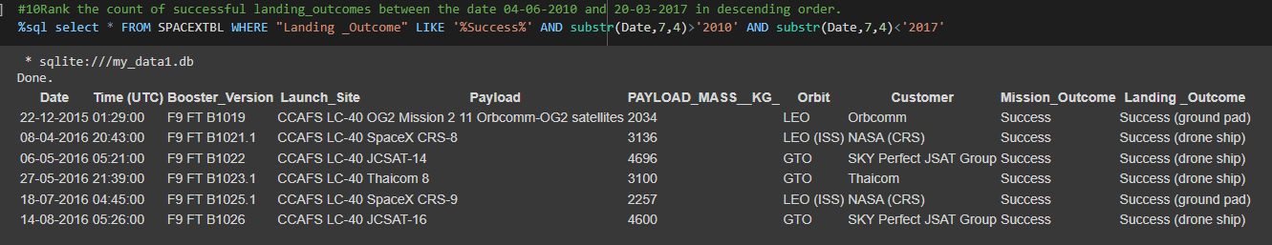
Rank Landing Outcomes Between 2010-06-04 and 2017-03-20

Slide 34

Section 3

Slide 35
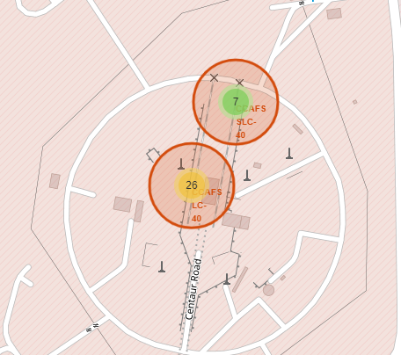
Rocket launch sites CCAFS LC-40 and CCAFS SLC-40

Slide 36
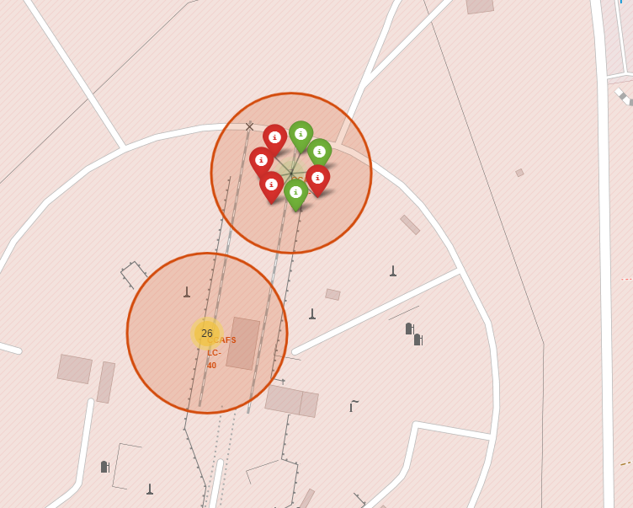
Rocket launch sites CCAFS LC-40 and CCAFS SLC-40
The color-labeled launch outcomes on the map

Slide 37

Distance between the coastline point and the launch site

Slide 38

Section 4

Slide 39
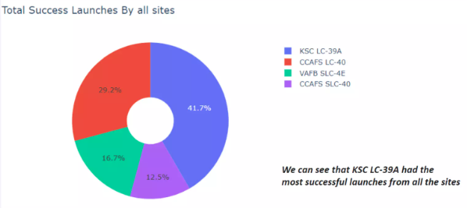
Total Success Launches by all sites

Slide 40
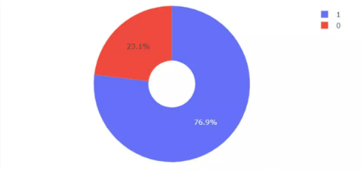
Success rate by site

Slide 41
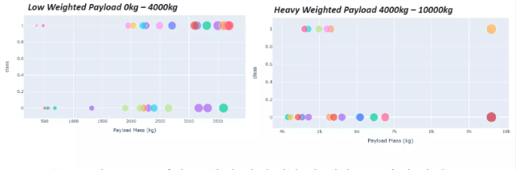
Payload vs launch outcome

Slide 42

Section 5

Slide 43
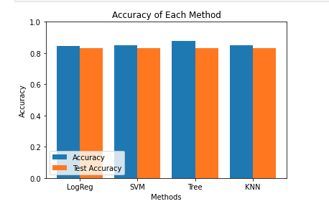
Classification Accuracy

Slide 44
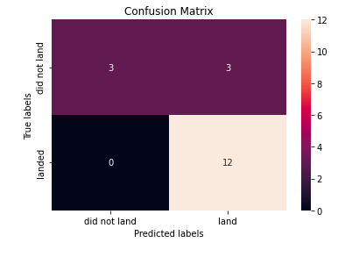
Confusion Matrix
In the logistic regression confusion matrix, the twelve successful landings that were predicted are true, it only fails to predict 3 successful landings that are not.

Slide 45
Conclusions
The work presented was developed mainly in Jupyter Lab and Google collaborated with data extracted from NASA, the libraries used are Pandas, Sklearn, Seaborn, Numpy, Matplotlib, Folium, Sqlite3 and Ploly.
Under the proposed models the main results were
The SVM, KNN, DT and Logistic Regression models give good results in terms of prediction accuracy for this data set.
Low weight payload performs better than heavier payloads.
SpaceX lunch success rates are directly proportional to the time in years that they will eventually perfect the lunches.
KSC LC 39A had the most successful launches of all the sites.
Orbit GEO, HEO, SSO, ES L1 has the best success rate.
Finally, it would be interesting to continue modifying the parameters of the machine learning models to see how the model varies and its effectiveness.

Slide 46


